Slide 1

Typing
Quiz
Review
Skillwise
Worksheet

Slide 2
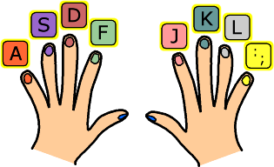
Typing Quiz
Level A

Slide 3
1. When typing on a computer keyboard, you head should be…
Tilted slightly forward
Erect
To one side
B – When using a computer, you should sit upright with your head erect.

Slide 4
2. When typing, you should hold your elbows…
Away from your body
Close to your body
However you like
B - The correct posture when typing is to keep your elbows close to your body.

Slide 5
3. On the QWERTY keyboard, the # sign is on the same key as ….
The number 3
The number 7
The number 4
A – Above the number 3. To type the # sign, you need to hold down the shift key first then press the key.

Slide 6
4. True or False - The QWERTY keyboard has the same key layout as a traditional typewriter?
True
False
A – True: The QWERTY keyboard is the most common keyboard layout, used for typewriters as well as for computer keyboards.

Slide 7
5. When touch typing, you type the letter H by using…
The index finger on your left hand
The index finger on your right hand
The middle finger on your left hand
B – the index finger (finger next to your thumb) moves one key to the left.

Slide 8
6. When touch typing, you type the letter G by using…
The index finger on your left hand
The index finger on your right hand
The middle finger on your left hand
A – The index finger (the finger next to your thumb) moves one key to the right.

Slide 9
7. True or False - While using a computer at work, your employer has no responsibility for your safety while using the keyboard?
True
False
B – There are various health problems associated with the regular use of computers. For this reason, employers must be aware of the regulations surrounding computer health and safety.

Slide 10
8. In touch typing, you type the letter E by using…
The middle finger of your right hand
The middle finger of your left hand
The index finger of your right hand
B – The middle finger of your left hand is the easiest to use when your fingers are on the home keys.

Slide 11
9. When typing an email address, a symbol you generally need is …
+
~
@
C – The @ sign means at and is normally in an email address.

Slide 12
10. The best way to learn to type is to …
Just start using the keyboard
Regularly practice using the correct keys for touch typing
Start off using one or two fingers and build up to using more fingers
B – If you want to learn to touch type, it is best to practice using all the correct fingers from the beginning so that typing becomes automatic.

Slide 13
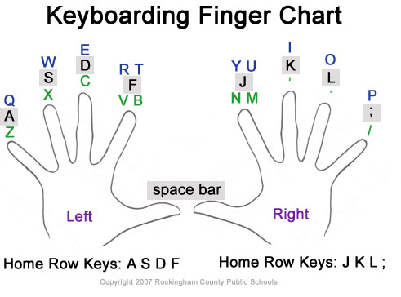
Typing Quiz
Level B

Slide 14
1. Where are the letters on a computer keyboard?
On the right
On the left
In the center
C – The letters are in the center of the keyboard.

Slide 15
2. Where is the question mark on the keyboard?
To the right of the letters on the keyboard
To the left of the letters on the keyboard
On the top row of the keyboard
A – The question mark is above the forward slash symbol to the right of the letters on the keyboard.

Slide 16
3. True or False - The cursor is the flashing horizontal line?
True
False
B - False: The cursor is a flashing vertical (upright) line.

Slide 17
4. True or False – When typing on a computer, your text will appear above the flashing cursor?
True
False
B – False: When you type on a computer, the flashing cursor points to where your text will appear.

Slide 18
5. What does the shift key do?
It lets you type capital letters only
It lets you type symbols only
It lets you type capital letters and symbols
C – If you hold the shift key down, it allows you to type both capital letters or symbols.

Slide 19
6. Where is the shift key on the keyboard?
On the right of the keyboard
On the left of the keyboard
On the left and the right of the keyboard
C – There is a shift key on the left and on the right side of the keyboard.

Slide 20
7. The symbol / below the question mark on the keyboard is called…
A backward slash
A forward slash
A slant
B – The forward slash is a punctuation mark, found on the same key as the ?
The symbol \ is the backward slash

Slide 21
8. Brackets (parentheses) can be found on the same keys as the numbers…
1 and 2
7 and 8
9 and 0
C – Brackets (parentheses) are punctuation marks found on keys above the numbers 9 and 0.

Slide 22
9. The symbol & means the same as “and” and is called the….
Ampersand
Addition
As well
A – The punctuation mark & means the same as “and” and is called the ampersand.

Slide 23
10. The percentage symbol is above the number?...
5
4
3
A – The percentage symbol % is on the same key as the number 5.

Slide 24
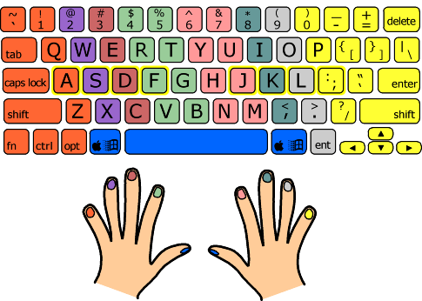
Typing Quiz
Level C

Slide 25
1. When typing a web address, which letter generally appears 3 times?
A
W
S
B – Most web addresses start with www. Which stands for the world wide web.

Slide 26
2. Where would you find the exclamation mark on the keyboard?
Above the hyphen - sign
Below the plus + sign
Above the number 1
C – The exclamation mark ! is above the number 1 on the top left hand side of the keyboard.

Slide 27
3. The symbol $ above the number 4 on the keyboard is…
The dollar sign
A euro sign
A yen sign
A – The symbol $ is used for dollars, which is the currency of the United States of America.

Slide 28
4. True or False – The punctuation mark “ is used to show direct speech or a quotation.
True
False
A – True: The speech marks “ can be found above the number 2 on the computer keyboard.

Slide 29
5. Which sign shows that something is equal?
&
=
#
B – The equal sign = can be found below the plus + sign on the computer keyboard.

Slide 30
6. True or False – The spell and grammar check on the computer helps you proofread your typing.
True
False
A – True: When word processing on a modern computer, it is useful to check for errors using the spell and grammar check.

Slide 31
7. Each letter, number or symbol you type is called a…
Symbol
Mark
Character
C – Whenever you type a letter, number or symbol it is called a character.

Slide 32
8. The computer displays the number of words you have typed.
True
False
Maybe
C – The computer displays the number of words in a document. If there are words already in the document, you will need to highlight the new words to check the number you have typed.

Slide 33
9. True or False - This question is written in italic font.
True
False
B – False: This font is bold. Italics looks like this.

Slide 34
10. True or False – Underlining looks like this.
True
False
A – True: Underlining is a computer function which makes your text stand out.

Slide 35
Email address at school
kellsworth24@fillmorecsd.org

